Slide 1
Sorting
Parinya Sanguansat

Slide 2
Selection Sort
Find the minimum value
Swap it with the value in the first position
Repeat the steps above for the remainder of the list (starting at the second position and advancing each time)
OR
Find the maximum value
Swap it with the value in the last position
Repeat the steps above for the remainder of the list (starting at the second position and advancing each time)

Slide 3
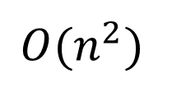
Selection Sort
Find max
public static void selectionSort(object[] d)
{
for (int k = d.Length - 1; k > 0; k--)
{
int m = k;
for (int j = 0; j < k; j++)
if (lessThan(d[m], d[j])) m = j;
swap(d, m, k); // d[m] <--> d[k]
}
}
$$O(n^{2})$$
private static bool lessThan(object a, object b)
{ return ((IComparable)a).CompareTo(b) < 0; }
private static void swap(object[] d, int i, int j)
{ object t = d[i]; d[i] = d[j]; d[j] = t; }

Slide 4
Bubble Sort
Compare a adjacency pair from first to last
If it is disorder then swap it
Remove the last position from the list
Repeat the steps above for the remainder of the list (starting at the first position)

Slide 5
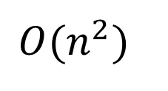
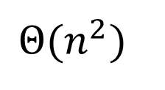
Bubble Sort
Normal
Add stop criterion
public static void bubbleSort(object[] d)
{
for (int k = d.Length; k > 1; k--)
for (int j = 1; j < k; j++)
if (lessThan(d[j], d[j - 1]))
swap(d, j - 1, j);
}
$$Θ(n^{2})$$
public static void bubbleSort(object[] d)
{
for (int k = d.Length; k > 1; k--)
{
bool sorted = true;
for (int j = 1; j < k; j++)
{
if (lessThan(d[j], d[j - 1]))
{
swap(d, j - 1, j);
sorted = false;
}
}
if (sorted) break;
}
}
$$O(n^{2})$$

Slide 6
Insertion Sort
Consider the k^{th} position
Insert the value in the k^{th} position into the list before k in the right order
Repeat above steps until the last position
≤ x | > x | x | …
Sorted
Unsorted

Slide 7
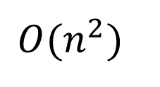
Insertion Sort
public static void insertionSort(object[] d)
{
for (int k = 1; k < d.Length; k++)
{
object t = d[k];
int j = k - 1;
while (j >= 0 && lessThan(t, d[j]))
{
d[j + 1] = d[j];
j--;
}
d[j + 1] = t;
}
}
$$O(n^{2})$$

Slide 8
Shell Sort
Donald Shell, 1959
Partition data into h partitions by h-1 step
Sort each partition by insertion sort
Set h = h – 1
Repeat above steps until h = 1
1
1
1
0
5
0
1
4
2
4
2
6
3
3
2
4
2
4
3
5
5
8
7
8
6
0
6
7
7
8
7
8
9
9
9

Slide 9
Shell Sort
Why shell sort quick?
Insertion is good for sorted data
Improve the insertion sort
Insertion sort is slow because there are more members in sorted list
1
1
1
3
3
4
2
4
5
5
2
4
2
0
0
8
7
8
6
6
7
8
7
9
9

Slide 10
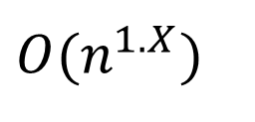
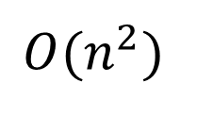
Shell Sort
public static void shellSort(object[] d)
{
for (int h = d.Length / 2; h > 0; h /= 2)
{
for (int m = 0; m < h; m++)
{
for (int k = h + m; k < d.Length; k += h)
{
object t = d[k]; int j = k - h;
while (j >= 0 && lessThan(t, d[j]))
{
d[j + h] = d[j]; j -= h;
}
d[j + h] = t;
}
}
}
}
Gonnet
h = h==2 ? 1 : (int)(h / 2.2))
Insertion sort
$$O(n^{1.X})$$
$$O(n^{2})$$

Slide 11
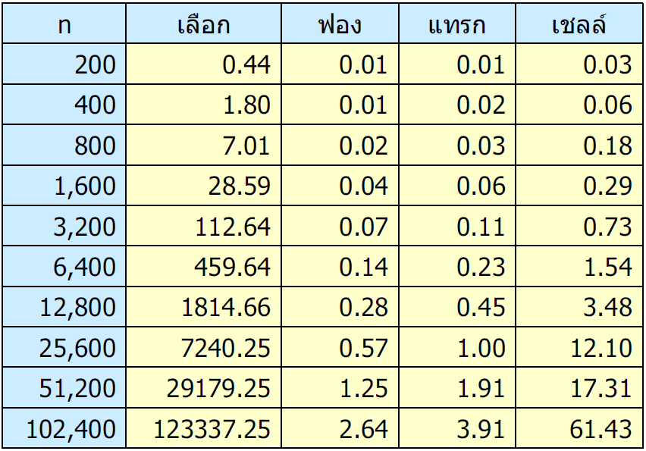
Performance comparisons
Sorted data

Slide 12
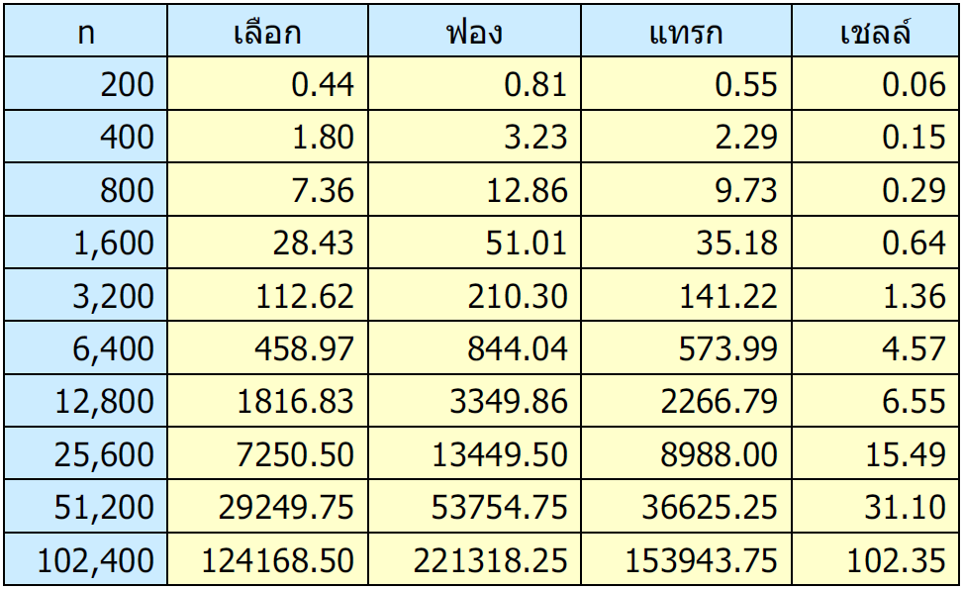
Performance comparisons
Invert sorted data

Slide 13
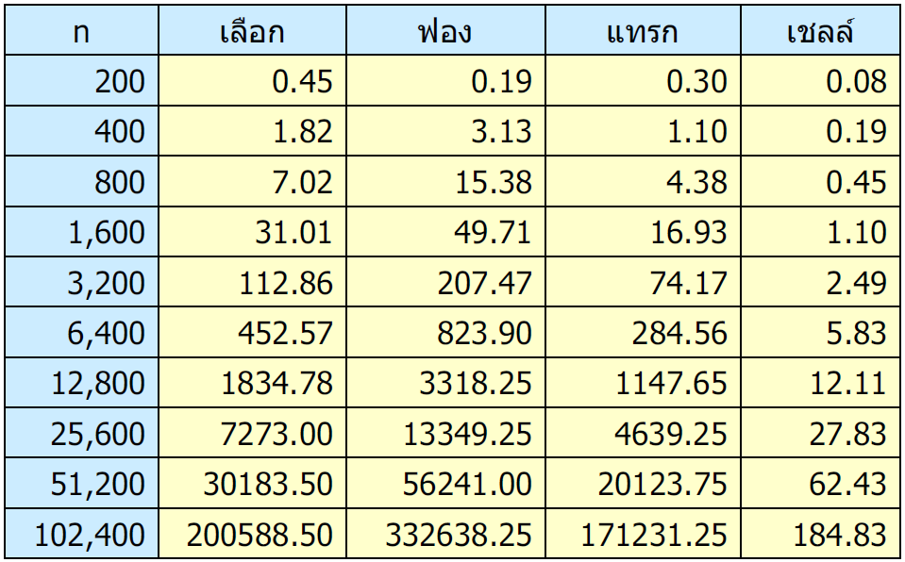
Performance comparisons
Random data

Slide 14
Heap Sort
Build Heap
Clone
Add one by one
Dequeue until it is empty

Slide 15
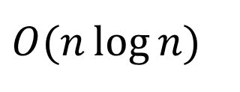
Heap Sort
Max Heap → Ascending order
Min Heap → Descending order
public static void heapSort(object[] x)
{
BinaryHeap h = new BinaryHeap(0);
h.data = x;
h.SIZE = x.Length;
for (int k = h.size() - 1; k >= 0; k--)
h.reorderDown(k);
for (int k = h.size() - 1; k > 0; k--)
x[k] = h.dequeue();//Ascend
}
$$O(n\log{n})$$

Slide 16
Merge Sort
Divide into n sublists, each containing 1 element
Repeatedly Merge sublists to produce new sublists until there is only 1 sublist remaining

Slide 17
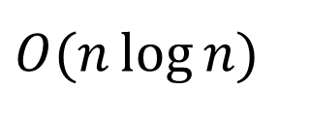
Merge Sort
public static void mergeSort(object[] d)
{ mSortR(d, 0, d.Length - 1, (object[])d.Clone()); }
private static void mSortR(object[] d, int left, int right, object[] t)
{
if (left < right)
{
int m = (left + right) / 2;
mSortR(t, left, m, d);
mSortR(t, m + 1, right, d);
merge(t, left, m, right, d);
}
}
static void merge(object[] a, int left, int mid, int right, object[] b)
{
int i = left, j = mid + 1;
for (int k = left; k <= right; k++)
{
if (i > mid) { b[k] = a[j++]; continue; }
if (j > right) { b[k] = a[i++]; continue; }
b[k] = lessThan(a[i], a[j]) ? a[i++] : a[j++];
}
}
$$O(n\log{n})$$

Slide 18
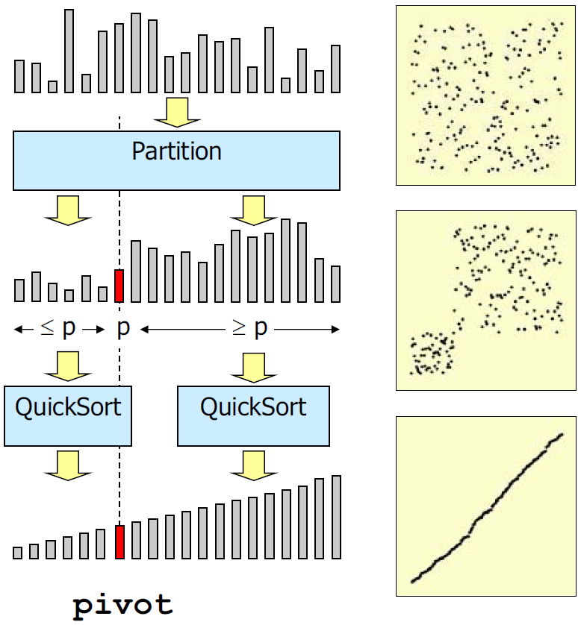
Quick Sort
Select a pivot (leftmost)
Swap the bigger values on the left with the lesser values to the right
Swap pivot with the last member of the lesser partition
Repeat above steps for each partition until cannot partition

Slide 19
Quick Sort
public static void quickSort(object[] d)
{
qSortR(d, 0, d.Length - 1);
}
static void qSortR(object[] d, int left, int right)
{
if (left < right)
{
int j = partition(d, left, right);
qSortR(d, left, j - 1);
qSortR(d, j + 1, right);
}
}
static int partition(object[] d, int left, int right)
{
object p = d[left];
int i = left, j = right + 1;
while (i < j)
{
while (lessThan(p, d[--j])) ;
while (lessThan(d[++i], p)) if (i == right) break;
if (i < j) swap(d, i, j);
}
swap(d, left, j);
return j;
}

Slide 20
Choices of pivot
Leftmost
Stackoverflow in sorted data (no data in the lesser set!)
Random
Median of three
object p = d[left];
Random r = new Random();
int m = left + (int)(r.NextDouble() * (right - left + 1));
swap(d, left, m);
object p = d[left];
L
C
R
C ≤ L ≤ R

Slide 21
Median of three
static int partition(object[] d, int left, int right)
{
int c = (left + right) / 2;
if (lessThan(d[left], d[c])) swap(d, left, c);
if (lessThan(d[right], d[c])) swap(d, c, right);
if (lessThan(d[right], d[left])) swap(d, left, right);
object p = d[left];
int i = left, j = right;
while (i < j)
{
while (lessThan(p, d[--j])) ;
while (lessThan(d[++i], p)) ;
if (i < j) swap(d, i, j);
}
swap(d, left, j);
return j;
}
L
C
R
C ≤ L ≤ R

Slide 22
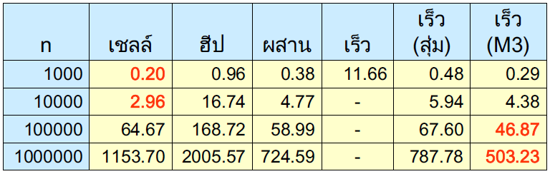
Performance comparisons
Sorted data

Slide 23
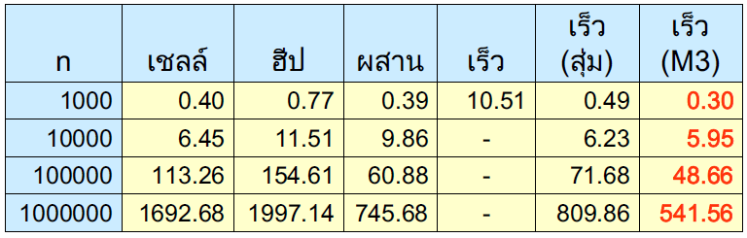
Performance comparisons
Invert sorted data

Slide 24
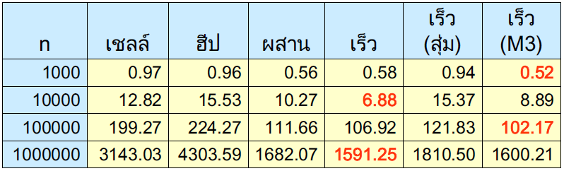
Performance comparisons
Random data

Slide 25
Conclusions
Bubble is not suitable in most cases
Selection sort uses minimum moves
Insertion sort is best for small data set
Shell sort is very quick
Merge sort is good for large data set but it need the extra space
The complexity of Heap sort is O(n log n) but slow
Quick sort is very quick with well implement

Slide 26
Class work: Sorting
Given data: 11, 7, 14, 3, 12, 0, 1, 15
Insertion sort
Selection sort (Take max)
Bubble sort
Shell sort (h=2)
Merge sort (left first)
Quick sort (leftmost)
Heap sort

